Slide 1
Project Title: Cervical Cancer Risk Analysis through ML Algorithms
Submitted by Sara Sameer
Note: This project is submitted for the evaluation of MATH189R summer course.

Slide 2
Problem Overview
Cervical cancer is a fatal disease found commonly in women. Although treatments and vaccines are available to treat this problem, but women from potentially low backgrounds are unable to access it. My aim to do this project is to find the risk prediction rate of cervical cancer in women and identify the most common predictors of this cancer.

Slide 3
Data Cleaning
Identified important features in dataset such as schiller and cytology, which can not be dropped.
From the three columns( smoke, smoke(years) and smoke(packs/year) ,we can remove the column smoke and smoke(packs/year) because Smoke(years) has non-zero value only when smoke column has a non-zero value.
As the number of sexual partners increase, the chances of getting tumors also increase. So number of sexual partners is also a key attribute in the model.

Slide 4
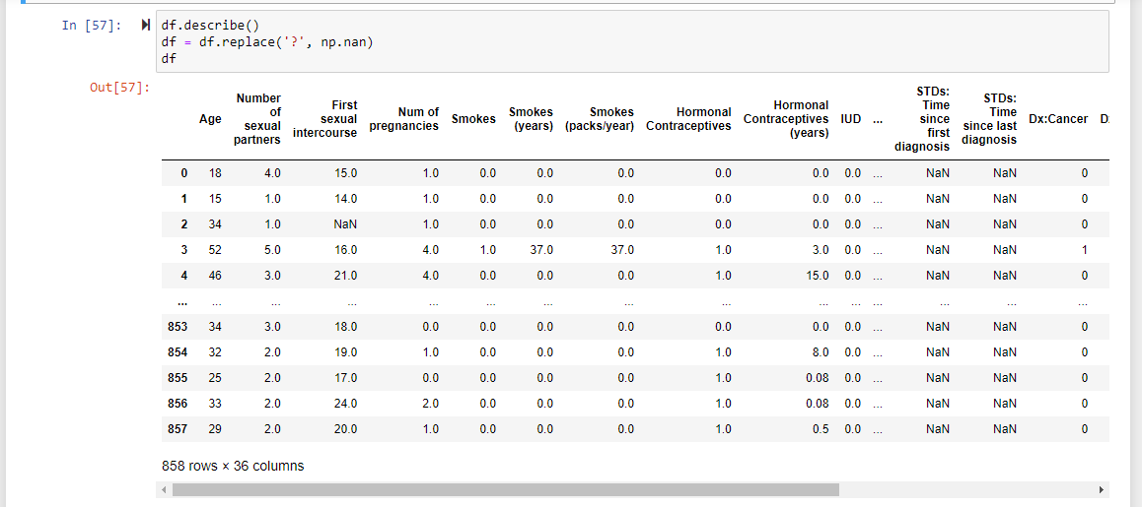
Data Set

Slide 5
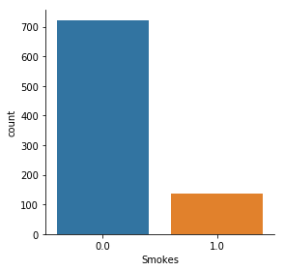
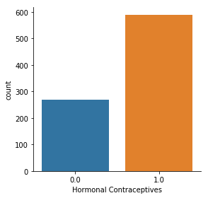
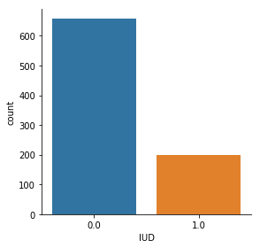


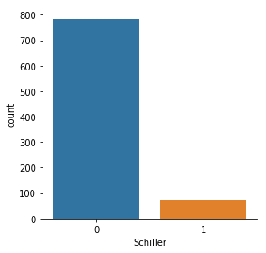
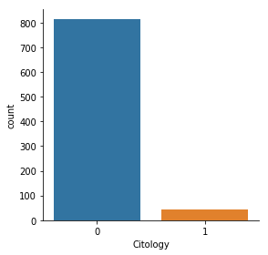

Features Analysis and Visualization

Slide 6
Data Preprocessing
Out of all features, biopsy is chosen as “Y” - the outcome feature. The value of Biopsy (0 or 1) represents the level of cervical cancer risk. 0 being no or low risk and 1 being more prone to the disease.
For the future work, I have planned to take four features as target variable to predict more accurate risk rate. These four features listed below are closely related to cervical cancer risk rate.
Hinselmann
Schiller
Citology
Biopsy
The next slide shows the implementation of data preprocessing.

Slide 7
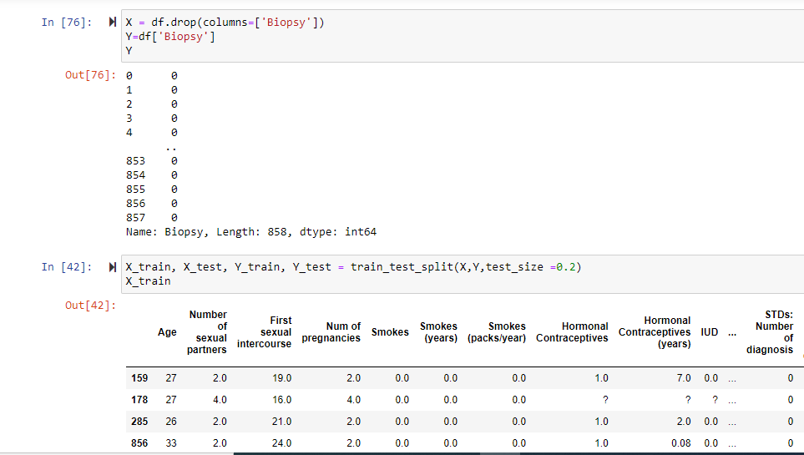

Slide 8
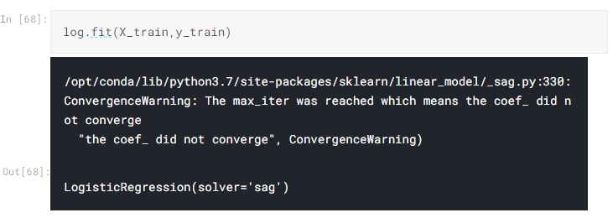
Classifier 01: Logistic Regression
Logistic regression (Solver: ‘sag’) is a not good algorithm to analyse the problem statement. The dataset was too complex to be fitted in a logistic regression classifier and the cost function was also not convex.

Slide 9
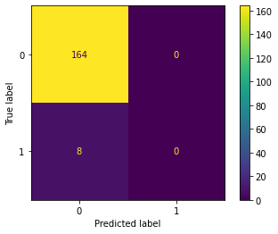
Confusion Matrix for Logistic Regression
Number of True Positives (11): 0
Number of False Positives(01): 0
Number of False Negatives(10): 8
Number of True Negatives(00): 164
Accuracy = (TP+TN) / (TP +TN +FP+FN)
= (0+164) / (0+164 +0+8)
= 0.95348837209
Precision = TP / (TP+FP)
= 0 / (0 +0) = ∞
Our logistic classifier fails to give precision, which means it fails to answer the question:
“When the model predicts a positive value, how often is it right?”

Slide 10
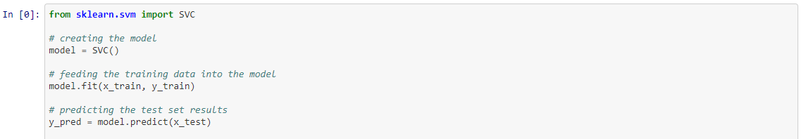
Classifier 02: Support Vector Classifier
Support vector classifier tries to find the best margin and reduces the risk of error on the data. It is a better approach than logistic regression where decision boundaries kept varying.

Slide 11
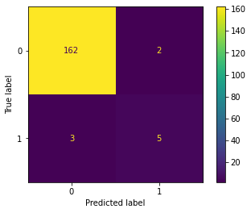
Confusion Matrix for Support Vector Classifier
Number of True Positives (11): 5
Number of False Positives(01): 2
Number of False Negatives(10): 3
Number of True Negatives(00): 162
Accuracy = (TP+TN) / (TP +TN +FP+FN)
= (5+162) / (5+162 +2+3)
= 0.97093023255
Precision = TP / (TP+FP)
= 5 / (5 +2) = 0.7143
This model is more accurate than logistic regression and precision is also close to 1 which is a plus point.

Slide 12
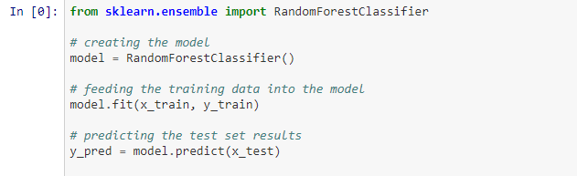
Classifier 03: Random Forest
It is one of the accurate machine learning algorithms that works quite good on large datasets. It is faster to train since we are dealing with only a subset of data with limited features in consideration.

Slide 13
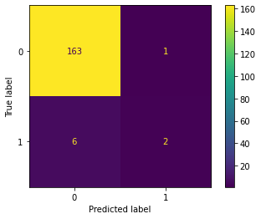
Confusion Matrix for Random Forest
Number of True Positives (11): 2
Number of False Positives(01): 1
Number of False Negatives(10): 6
Number of True Negatives(00): 163
Accuracy = (TP+TN) / (TP +TN +FP+FN)
= (2+163) / (2+163 +1+6)
= 0.95930232558
Precision = TP / (TP+FP)
= 2 / (2 +1) = 0.667
The accuracy and precision of random forest suggest that though it is better than Logistic Regression, yet SVM is still the best model choice so far. The kernel trick is real strength of SVM.

Slide 14
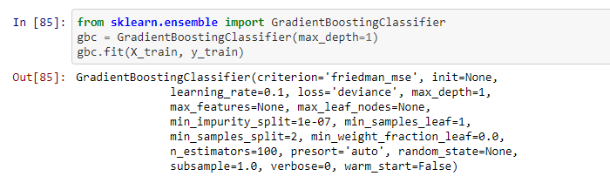
Classifier 04: Gradient Boosting Classifier
To compare the results from random forest model, gradient boosting classifier is the best choice. Gradient boosting minimizes the loss function by pointing it towards a weak hypothesis. Decision trees are usually used in gradient boosting classifiers.

Slide 15
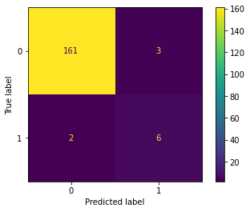
Confusion Matrix for Gradient Boosting Classifier
Number of True Positives (11): 6
Number of False Positives(01): 3
Number of False Negatives(10): 2
Number of True Negatives(00): 161
Accuracy = (TP+TN) / (TP +TN+FP+FN)
= (6+161) / (6+161 +3+2)
= 0.97093023255
Precision = TP / (TP+FP)
= 6 / (6 +3) = 0.6667
The accuracy rate is similar to the Support Vector Classifier, but the precision rate is slightly lower than SVC.
However, Gradient Boosting Classifier is still a good model for this dataset.

Slide 16
Acknowledgements
Dataset:
https://archive.ics.uci.edu/ml/datasets/Cervical+cancer+%28Risk+Factors%29
https://www.kaggle.com/loveall/cervical-cancer-risk-classification
GitHub:
https://github.com/sharmaroshan/Cervical-Cancer-Prediction
https://github.com/lauramann/cervicalCancerAnalysis
Youtube:
https://www.youtube.com/watch?v=prWyZhcktn4 (Confusion Matrix Explanation)
https://www.youtube.com/watch?v=7eh4d6sabA0 (Machine learning in python)
Kaggle:
https://www.kaggle.com/kiseokyang/cerv-canc-classification-w-multiple-classifiers/data#Import-libraries
https://www.kaggle.com/ravaliraj/risk-classification-of-cervical-cancer

Slide 17
Thank You

